Slide 1
Recursion

Slide 2
Definition
Programming technique
A function can call itself
Eventually hit a base case and return
One of the central ideas of computer science
It's super effective!
"The power of recursion evidently lies in the possibility of defining an infinite set of objects by a finite statement. In the same manner, an infinite number of computations can be described by a finite recursive program, even if this program contains no explicit repetitions." – Niklaus Wirth
"I'm lovin' it" – Charles Ponzi

Slide 3
World’s Simplest Recursion Program
def count (index):
print (index)
if index < 2:
count(index+1)
return
if __name__ == '__main__':
count(0)
This is where the recursion occurs.
You can see that the count() function
calls itself.

Slide 4
Visualizing Recursion
To understand how recursion works, it helps to visualize what’s going on.
To help visualize, we will use a common concept called the Stack.
A stack basically operates like a container of trays in a cafeteria. It has only two operations:
Push: you can push something onto the stack.
Pop: you can pop something off the top of the stack.
Let’s see an example stack in action.

Slide 5
Stacks
The diagram below shows a stack over time.
We perform two pushes and one pop.
8
2
2
2
Time: 0
Empty Stack
Time 1:
Push “2”
Time 2:
Push “8”
Time 3:
Pop: Gets 8
Time 4:
Pop: Gets 2

Slide 6
Stacks and Methods
When you run a program, the computer creates a stack for you.
Each time you invoke a method, the method is placed on top of the stack.
When the method returns or exits, the method is popped off the stack.
The diagram on the next page shows a sample stack for a simple program.

Slide 7
Stacks and Methods
square()
main()
main()
main()
Time: 0
Empty Stack
Time 1:
Push: main()
Time 2:
Push: square()
Time 3:
Pop: square()
returns a value.
method exits.
Time 4:
Pop: main()
returns a value.
method exits.

Slide 8
Stacks and Recursion
Each time a method is called, you push the method on the stack.
Each time the method returns or exits, you pop the method off the stack.
If a method calls itself recursively, you just push another copy of the method onto the stack.
We therefore have a simple way to visualize how recursion really works.

Slide 9
Back to the Simple Recursion Program
Here’s the code again. Now, that we understand stacks, we can visualize the recursion.
def count (index):
print (index)
if index < 2:
count(index+1)
return
if __name__ == '__main__':
count(0)
Notes:
Output:
0
1
2

Slide 10
Stacks and Recursion in Action
count(2)
count(1)
count(1)
count(0)
count(0)
count(0)
main()
main()
main()
main()
…
Time: 0
Empty Stack
Time 1:
Push: main()
Time 2:
Push: count(0)
Time 3:
Push:
count(1)
Time 4:
Push:
count(2)
Times 5-8:
Pop everything
Inside count(0):
print (index) → 0
if index < 2: count(index+1)
Inside count(1):
print (index)
→ 1
if index < 2: count(index+1)
Inside count(2):
print (index)
→ 2
if index < 2:
count(index+1)
This condition now fails!
Hence, recursion stops, and we proceed to pop all functions off the stack.
Notes:
Upon return, the function is popped out of the stack, returning the flow control back to the parent call

Slide 11
Recursion, Variation 1
What will the following program do?
def count (index):
print (index)
if index < 2:
count(index+1)
return
if __name__ == '__main__':
count(3)
Notes:
Output:
3
Just hit the base case (no recursion) and then return

Slide 12
Recursion, Variation 2
What will the following program do?
def count (index):
if index < 2:
count(index+1)
print (index)
return
if __name__ == '__main__':
count(0)
Note that the print statement
has been moved to the end
of the method.
Notes:
Output:
2
1
0

Slide 13
Recursion Example #2

Slide 14
Recursion Example #2
def upAndDown (n):
print(“Level:”,n)
if n < 4:
upAndDown(n+1)
print(“LEVEL:”,n)
return
upAndDown(1)
Recursion occurs here.

Slide 15
Determining the Output
Suppose you were given this problem on the final exam, and your task is to “determine the output.”
How do you figure out the output?
Answer: Use Stacks to Help Visualize

Slide 16
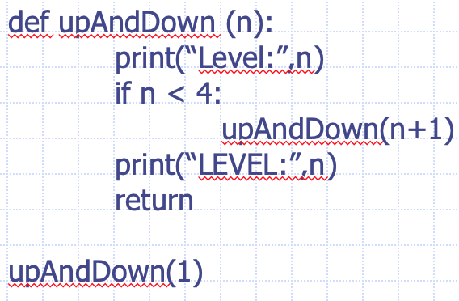
Stack Short-Hand
Rather than draw each stack like we did last time, you can try using a short-hand notation.
time stack output
time 0: empty stack
time 1: f(1) Level: 1
time 2: f(1), f(2) Level: 2
time 3: f(1), f(2), f(3) Level: 3
time 4: f(1), f(2), f(3), f(4) Level: 4
time 5: f(1), f(2), f(3) LEVEL: 4
time 6: f(1), f(2) LEVEL: 3
time 7: f(1) LEVEL: 2
time 8: empty LEVEL: 1

Slide 17
Factorials
Computing factorials are a classic problem for examining recursion.
A factorial is defined as follows:
n! = n * (n-1) * (n-2) …. * 1;
For example:
1! = 1 (Base Case)
2! = 2 * 1 = 2
3! = 3 * 2 * 1 = 6
4! = 4 * 3 * 2 * 1 = 24
5! = 5 * 4 * 3 * 2 * 1 = 120

Slide 18
Iterative Approach
def findFactorialIterative(n)
if n<0:
return 0
factorial = 1
while n>0:
factorial = factorial*n
n = n-1
return factorial
print(findFactorialInterative(5))
This is an iterative solution to finding a factorial.
It’s iterative because we have a simple while loop.
Note that the while loop goes from n to 1.

Slide 19
Factorials
Computing factorials are a classic problem for examining recursion.
A factorial is defined as follows:
n! = n * (n-1) * (n-2) …. * 1;
For example:
1! = 1 (Base Case)
2! = 2 * 1 = 2
3! = 3 * 2 * 1 = 6
4! = 4 * 3 * 2 * 1 = 24
5! = 5 * 4 * 3 * 2 * 1 = 120
If you study this table closely, you
will start to see a pattern.
The pattern is as follows:
You can compute the factorial of
any number (n) by taking n and
multiplying it by the factorial of (n-1).
For example:
5! = 5 * 4!
(which translates to 5! = 5 * 24 = 120)

Slide 20
Seeing the Pattern
Seeing the pattern in the factorial example is difficult at first.
But, once you see the pattern, you can apply this pattern to create a recursive solution to the problem.
Divide a problem up into:
What it can do (usually a base case)
What it cannot do
What it cannot do resembles original problem
The function launches a new copy of itself (recursion step) to solve what it cannot do.

Slide 21
Recursive Solution
def findFactorialR(n)
if n<0:
return 0
elif n==0 or n==1:
return 1
return n*findFactorialR(n-1)
print(findFactorialR(5))

Slide 22
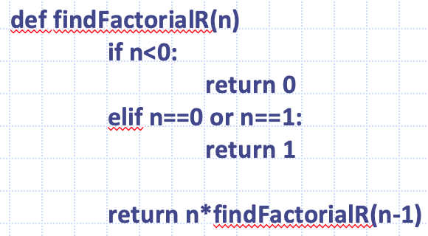
Finding the factorial of 3
fact(1)
1
fact(2)
fact(2)
fact(2)
2
fact(3)
fact(3)
fact(3)
fact(3)
fact(3)
6
main()
main()
main()
main()
main()
main()
Time 2:
Push: fact(3)
Time 3:
Push: fact(2)
Time 4:
Push: fact(1)
Time 5:
Pop: fact(1)
returns 1.
Time 6:
Pop: fact(2)
returns 2.
Time 7:
Pop: fact(3)
returns 6.
Inside findFactorialR(3):
return 3 * factorial (2)
Inside findFactorialR(2):
return 2 * factorial (1)
Inside findFactorialR(1):
elif n==0 or n==1:
return 1;

Slide 23
Recursion vs. Iteration
Iteration
Uses repetition structures (for, while or do…while)
Repetition through explicitly use of repetition structure
Terminates when loop-continuation condition fails
Controls repetition by using a counter
Recursion
Uses selection structures (if, if…else)
Repetition through repeated method calls
Terminates when base case is satisfied
Controls repetition by dividing problem into simpler one

Slide 24
Recursion vs. Iteration (cont.)
Recursion
More overhead than iteration
Overhead: more computation and extra memory and context switching
More memory intensive than iteration
Can also be solved iteratively
Often can be implemented with only a few lines of code

Slide 25
Characteristics of a Recursive Method
Calls itself to solve a smaller problem
Simplifies the initial problem conceptually
Base case
Smallest problem to be solved
Result is returned to the calling method (Terminal condition)
Induces overhead
Transfer of the control to the beginning of the method
Storage of all return points, intermediate arguments, return values in program stack

Slide 26
Recursive Binary Search
Binary search can also be a recursion
Method calls itself with new starting and ending values
Base case: starting value > end value (zero elements in Python list to check)

Slide 27
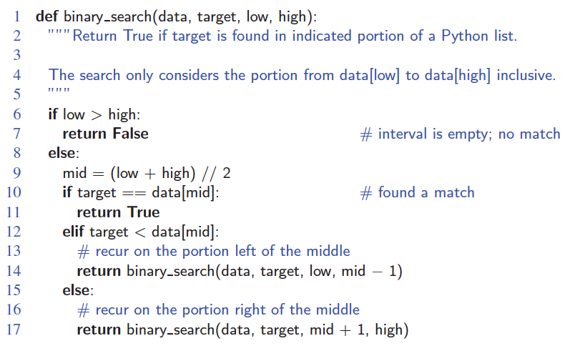
Binary Search
Search for an integer, target, in an ordered list.

Slide 28
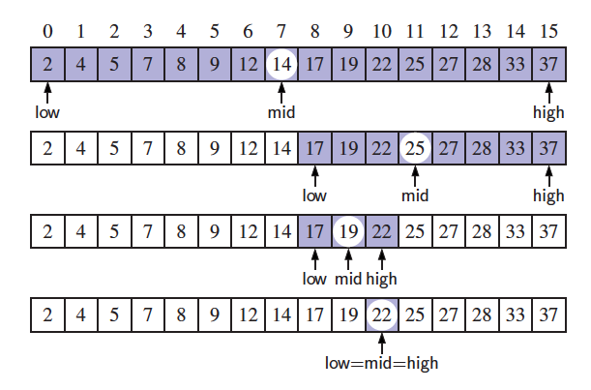
Visualizing Binary Search
We consider three cases:
If the target equals data[mid], then we have found the target.
If target < data[mid], then we recur on the first half of the sequence.
If target > data[mid], then we recur on the second half of the sequence.

Slide 29
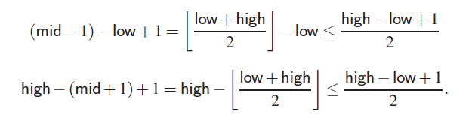
Analyzing Binary Search
Runs in O(log n) time.
The remaining portion of the list is of size high – low + 1.
After one comparison, this becomes one of the following (Half size):
Thus, each recursive call divides the search region in half; hence, there can be at most log n levels (steps).

Slide 30
Recursion structure
Runtime at each level
n
O(1)
n/2
O(1)
n/2²
O(1)
Depth of path is = O(?)
Sum over all runtime at each node:
O(1) + O(1) … O(1) = ?
n/2^{k}
O(1)
1
O(1)

Slide 31
Recurrence equation
Base case: T(1) = c when n = 1
T(n) = T(n/2) + c if n >= 2
= T(n/2²) + c + c (by subst.)
= T(n/2³) + c + c + c (by subst.)
= …
= T(n/2^{k}) + c * k
In the worst case, at the end the search space should be reduced to 1 element
n/2^{k} = 1 => k = log₂(n); T(n) is O(log n)

Slide 32
Linear Recursion
Test for base cases
Begin by testing for a set of base cases (there should be at least one).
Every possible chain of recursive calls must eventually reach a base case, and the handling of each base case should not use recursion.
Recur once
Perform a single recursive call
This step may have a test that decides which of several possible recursive calls to make, but it should ultimately make just one of these calls
Define each possible recursive call so that it makes progress towards a base case.

Slide 33
Example of Linear Recursion
Example recursion trace:
Algorithm LinearSum(A, n):
Input:
A integer array A and an integer n = 1, such that A has at least n elements
Output:
The sum of the first n integers in A
if n = 1 then
return A[0]
else
return LinearSum(A, n - 1) + A[n - 1]
call
return
15
+
A
[
4
] =
15
+
5
=
20
LinearSum
(
A
,
5
)
call
return
13
+
A
[
3
] =
13
+
2
=
15
LinearSum
(
A
,
4
)
call
return
7
+
A
[
2
] =
7
+
6
=
13
LinearSum
(
A
,
3
)
call
return
4
+
A
[
1
] =
4
+
3
=
7
LinearSum
(
A
,
2
)
return
A
[
0
] =
call
4
LinearSum
(
A
,
1
)

Slide 34
Reversing an Array
Algorithm ReverseArray(A, i, j):
Input: An array A and nonnegative integer indices i and j
Output: The reversal of the elements in A starting at index i and ending at j
if i < j then
Swap A[i] and A[ j]
ReverseArray(A, i + 1, j - 1)
return

Slide 35
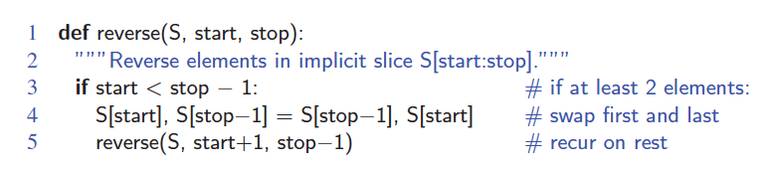
Defining Arguments for Recursion
In creating recursive methods, it is important to define the methods in ways that facilitate recursion.
This sometimes requires we define additional parameters that are passed to the method.
For example, we defined the array reversal method as ReverseArray(A, i, j).
Python version:

Slide 36
Helper function
A function that calls the recursive function
End user don’t need to know how to enter the input arguments to recursive function
def reverse_helper(S):
reverse(S, 0, len(S))

Slide 37
Recursion structure
Runtime at each level
n
Assume n is even
O(1)
n-2
O(1)
n-2*2
O(1)
Depth of path = ?
Sum over all runtime at each node:
O(1) + O(1) … O(1) = ?
n-2k
O(1)
0
O(1)

Slide 38
Recurrence equation
Base cases: T(0) = c, T(1) = c
T(n) = T(n-2) + c if n >= 2
= T(n-4) + c + c (by subst.)
= T(n-6) + c + c + c (by subst.)
= …
= T(n-2*k) + c * k
At the end, the problem is reduced to 0 or 1 element
n-2*k = 0 => k = n/2; T(n) is O(n)

Slide 39
Computing Powers
The power function, p(x,n)=x^{n}, can be defined recursively:
This leads to an power function that runs in O(n) time (for we make n recursive calls).
We can do better than this, however.

Slide 40
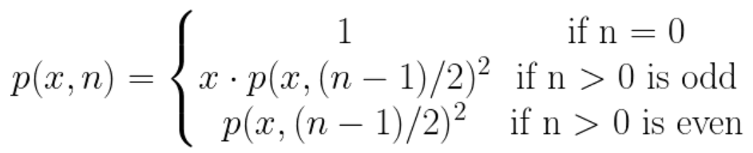
Recursive Squaring
We can derive a more efficient linearly recursive algorithm by using repeated squaring:
For example,
2⁴ = 2^{(4/2)2} = (2^{4/2})² = (2²)² = 4² = 16
2⁵ = 2^{1+(4/2)2} = 2(2^{4/2})² = 2(2²)² = 2(4²) = 32
2⁶ = 2^{(6/ 2)2} = (2^{6/2})² = (2³)² = 8² = 64
2⁷ = 2^{1+(6/2)2} = 2(2^{6/2})² = 2(2³)² = 2(8²) = 128.

Slide 41
Recursive Squaring Method
Algorithm Power(x, n):
Input: A number x and integer n = 0
Output: The value x^{n}
if n = 0 then
return 1
if n is odd then
y = Power(x, (n - 1)/ 2)
return x · y ·y
else
y = Power(x, n/ 2)
return y · y

Slide 42
Analysis
Algorithm Power(x, n):
Input: A number x and integer n = 0
Output: The value x^{n}
if n = 0 then
return 1
if n is odd then
y = Power(x, (n - 1)/ 2)
return x · y · y
else
y = Power(x, n/ 2)
return y · y
Each time we make a recursive call we halve the value of n; hence, we make log n recursive calls. That is, this method runs in O(log n) time.
It is important that we use a variable twice here rather than calling the method twice.

Slide 43
Tail Recursion
Tail recursion occurs when a linearly recursive method makes its recursive call as its last step.
The array reversal method is an example.
Such methods can be easily converted to non-recursive methods (which saves on some resources).
Example:
Algorithm IterativeReverseArray(A, i, j ):
Input: An array A and nonnegative integer indices i and j
Output: The reversal of the elements in A starting at index i and ending at j
while i < j do
Swap A[i ] and A[ j ]
i = i + 1
j = j - 1
return

Slide 44
Binary Recursion
Binary recursion occurs whenever there are two recursive calls for each non-base case.

Slide 45
Binary Recusive Method
Problem: add all the numbers in an integer array A:
Algorithm BinarySum(A, i, n):
Input: An array A and integers i and n
Output: The sum of the n integers in A starting at index i
if n = 1 then
return A[i ]
return BinarySum(A, i, n/ 2) + BinarySum(A, i + n/ 2, n/ 2)
Example trace:
Runtime at each level
0
,
8
O(1) * 2⁰
0
O(1) * 2¹
,
4
4
,
4
0
,
2
2
,
2
4
,
2
6
,
2
O(1) * 2²
0
,
1
1
O(1) * 2³
,
1
2
,
1
3
,
1
4
,
1
5
,
1
6
,
1
7
,
1
Notes:
T(n) = 2 * T(n/2) + c
O(n)

Slide 46
Computing Fibonacci Numbers
Fibonacci numbers are defined recursively:
F₀ = 0
F₁ = 1
F_{i} = F_{i-1} ⁺ F_{i-2} for i > 1.
Recursive algorithm (first attempt):
Algorithm BinaryFib(k):
Input: Nonnegative integer k
Output: The kth Fibonacci number F_{k}
if k = 0 then
return k
else if k = 1 then
return k
else
return BinaryFib(k - 1) + BinaryFib(k - 2)

Slide 47
Analysis
Let n_{k} be the number of function calls by BinaryFib(k)
n₀ = 1
n₁ = 1
n₂ = n₁ + n₀ + 1 = 1 + 1 + 1 = 3
n₃ = n₂ + n₁ + 1 = 3 + 1 + 1 = 5
n₄ = n₃ + n₂ + 1 = 5 + 3 + 1 = 9
n₅ = n₄ + n₃ + 1 = 9 + 5 + 1 = 15
n₆ = n₅ + n₄ + 1 = 15 + 9 + 1 = 25
n₇ = n₆ + n₅ + 1 = 25 + 15 + 1 = 41
n₈ = n₇ + n₆ + 1 = 41 + 25 + 1 = 67.
Note that n_{k} at least doubles every other time
That is, n_{k} > 2^{k/2}. It is exponential!

Slide 48
Recursion structure
Runtime at each level (Upper bound)
n
O(1) * 2⁰
n-1
n-2
O(1) * 2¹
n-2
n-3
O(1) * 2²
n-3
n-4
O(1) * 2³
1
0
O(1) * 2^{n-1}

Slide 49
Recurrence equation
Base cases: T(0) = c, T(1) = c
T(n) = T(n-1) + T(n-2) + c if n >= 2
< 2*T(n-1) + c
= 2(2*T(n-2) + c) + c (by subst.)
= 2²T(n-2) + 2¹c + c
= …
= 2^{k}T(n-k) + 2^{k-1}c + … + 2¹c + 2⁰c
At the end, n-k is reduced to 1
=> k = n-1; T(n) is O(2^{n}), exponential

Slide 50
A Better Fibonacci Algorithm
Use linear recursion instead
Algorithm LinearFibonacci(k):
Input: A nonnegative integer k
Output: Pair of Fibonacci numbers (F_{k} , F_{k−1})
if k = 1 then
return (k, 0) // return current & previous
else
(i, j) = LinearFibonacci(k − 1)
return (i+j, i)
LinearFibonacci makes k−1 recursive calls
Runtime is O(k)

Slide 51
In-class exercise
Please download decimal_to_binary_class.py from Brightspace.nyu.edu
Suppose n is a positive integer, n >= 0. Convert n to its binary representation as string using recursion, without using any library function.
Submit your code to Gradescope

Slide 52
Multiple Recursion
Multiple recursion:
makes potentially many recursive calls
not just one or two

Slide 53
Algorithm for Multiple Recursion
Algorithm PuzzleSolve(k,S,U):
Input: Integer k, sequence S, and set U (universe of elements to test)
Output: Enumeration of all k-length extensions to S using elements in U without repetitions
for all e in U do
Remove e from U {e is now being used}
Add e to the end of S
if k = 1 then
Test whether S is a configuration that solves the puzzle
if S solves the puzzle then
return “Solution found: ” S
else
PuzzleSolve(k - 1, S,U)
Add e back to U {e is now unused}
Remove e from the end of S

Slide 54
Visualizing PuzzleSolve
Initial call
PuzzleSolve
(
3
,
()
,{
a
,
b
,
c
}
)
PuzzleSolve
(
2
,
b
,{
a
,
c
}
)
PuzzleSolve
(
2
,
c
,{
a
,
b
PuzzleSolve
}
)
(
2
,
a
,{
b
,
c
}
)
PuzzleSolve
(
1
,
ab
,{
c
}
)
PuzzleSolve
(
1
,
ba
,{
c
}
)
PuzzleSolve
(
1
,
ca
,{
b
}
)
abc
bac
cab
PuzzleSolve
(
1
,
ac
,{
b
}
)
PuzzleSolve
(
1
,
bc
,{
a
}
)
PuzzleSolve
(
1
,
cb
,{
a
}
)
acb
bca
cba

Slide 55
Divide-and-Conquer
Recursive binary search is an example of divide-and-conquer
Idea
Divide the bigger problem into smaller problems
Solve each smaller problem separately
If smaller problem still too big, then solve its divisions
Continue process until smaller problem is a base case
DaC can be used with recursion as well as non recursion

Slide 56
Towers of Hanoi
Invented by Edouard Lucas in 1883
Three towers
64 gold disks (decreasing sizes) placed on the first tower
All disks must be moved from the Source tower to the Destination Tower
Larger disks can not be placed on top of smaller disks
The third tower can be used to temporarily hold disks

Slide 57
Towers of Hanoi
S
D
I

Slide 58
Towers of Hanoi
S
D
I

Slide 59
Towers of Hanoi
S
D
I

Slide 60
Towers of Hanoi
S
D
I

Slide 61
Towers of Hanoi
S
D
I

Slide 62
Towers of Hanoi
S
D
I

Slide 63
Towers of Hanoi
S
D
I

Slide 64
Towers of Hanoi
S
D
I

Slide 65
ToH – Recursive Solution
Model
Source tower S
Intermediate tower I
Destination tower D
Assume n disks on S
Move subtree (top n-1) disks from S to I
Move the remaining (largest) disk from S to D
Move the subtree from I to D.

Slide 66
ToH – Recursive Solution (Moving disks from Tower A (Source) to C (Destination))

Slide 67
ToH – Recursive Algorithm
def Hanoi(topN, from, inter, to):
if topN == 1: // base case
Move(1, from, to);
else: // recursion
Hanoi(topN-1, from, to, inter); // from → inter
Move(topN, from, to);
Hanoi(topN-1, inter, from, to); // inter → to
Notes:
T(1) = c // base case
Recurrence:
T(N) = 2 * T(N-1) + c
= 2 * (2 * T(N-2) + c) + c
= 2^2 T(N-2) + 2^1*c + 2^0 * c
= 2 * (2 * (2*T(N-4) + c) + c) + c
= …
= 2^{N-1} T(N-N-1)) + c * sum_i_{0}^{N-1} 2^i //N-1 terms in the 2nd sum
= O(2^N)

Slide 68
Runtime of Recursive Functions
Please complete in-class exercise in Gradescope and submit your answers
def recursiveFun1(n):
if n<=0:
return 1
else:
return 1+recursiveFun1(n-1)
Notes:
O(n)

Slide 69
Runtime of Recursive Functions
def recursiveFun2(n):
if n<=0:
return 1
else:
return 1+recursiveFun2(n-5)
Notes:
O(n).
N – 5*k = 0 ends recursion. This implies k = N/5. In other words, O(N)

Slide 70
Runtime of Recursive Functions
def recursiveFun3(n):
if n<=0:
return 1
else:
return 1+recursiveFun3(n//5)
Notes:
O(log N)

Slide 71
Runtime of Recursive Functions
def recursiveFun4(n,m,o):
if n<=0:
print(m,”,”,o)
else:
recursiveFun4(n-1,m+1,o)
recursiveFun4(n-1,m,o+1)
Notes:
T(N) = 2 T(N-1) + c
O(2^N)

Slide 72
Runtime of Recursive Functions
def recursiveFun5(n):
for i in range(0,n,2):
print(“hello”)
if n<=0:
return 1
else:
return 1+recursiveFun5(n-5)
Notes:
T(n) = T(n-5) + O(n)
O(N^2)
Two questions to consider:
1. Think about how many recursive calls it takes?
2. Within each call, how many operations it takes?

Slide 73
Supplementary materials

Slide 74

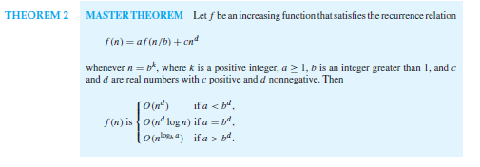

Divide and Conquer Master Method

Slide 75
Practice Master Method

Slide 76
Practice Master Method

Slide 77
Practice Master Method (Can’t apply always)

